Slide 1


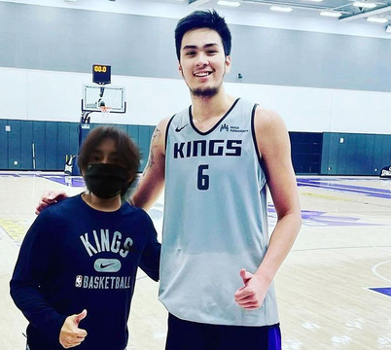









PROPONENTS:
Gallardo,
Matthew
Guevarra, John Joemer
Rapiza,
Leinard V.
Back to Agenda Page

Slide 2



LSTM- BASED DEEPFAKE DETECTION IN VIDEOS
GET STARTED
11:11PM

Slide 3
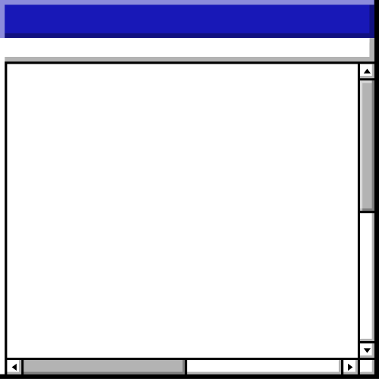

Problem Statement:
To Design and Develop a web-based system and method to classify the video as deepfake or real.
Back to Agenda Page

Slide 4






WHAT IS DEEPFAKE?
Deep fake refers to a technique that uses artificial intelligence (AI) to create manipulated media, such as images, videos, or audio recordings, that convincingly depict individuals doing or saying things they never actually did or said. This technology employs a specific type of AI called a generative adversarial network (GAN) to combine and superimpose existing media onto source media, resulting in highly realistic and deceptive content. Deep fakes can have both positive applications in entertainment and creative industries, but they also raise significant concerns due to their potential for spreading misinformation, fake news, and compromising individuals' privacy and reputation. Efforts are ongoing to detect and mitigate the misuse of deep fake technology and promote responsible usage and safeguards.
11:11PM

Slide 5

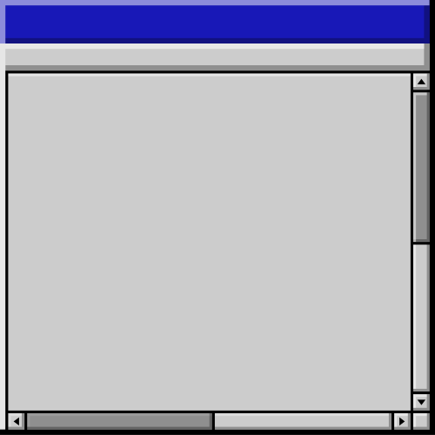
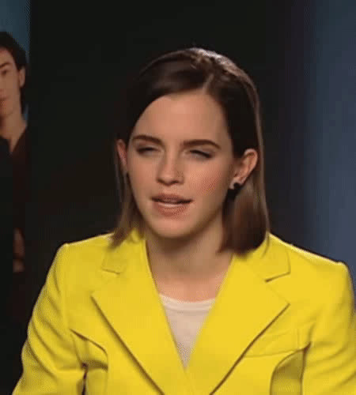


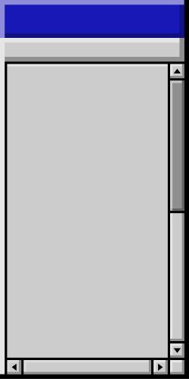
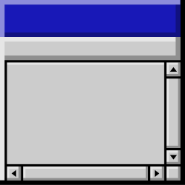

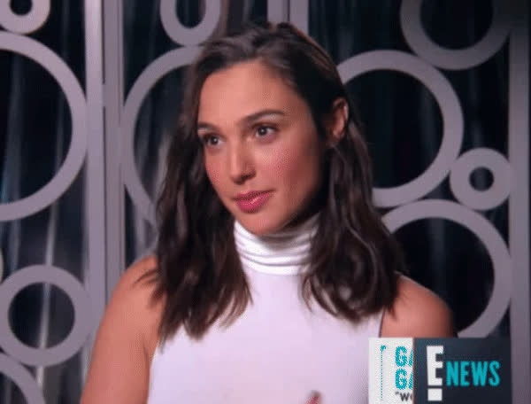

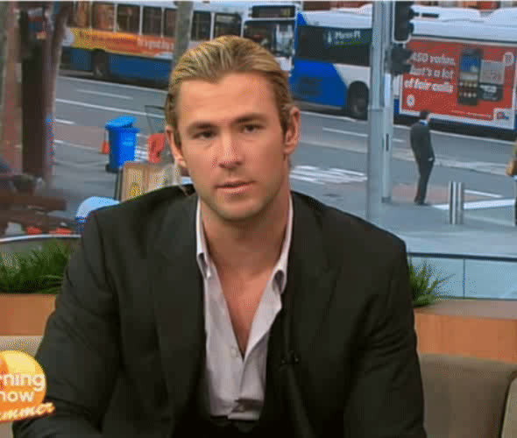
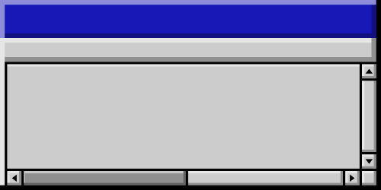
DEEPFAKE OR REAL?

Slide 6














LSTM-BASED DEEPFAKE DETECTION • LSTM-BASED DEEPFAKE DETECTION • LSTM-BASED DEEPFAKE DETECTION• LSTM-BASED DEEPFAKE DETECTION
HOW DEEPFAKES ARE CREATED:
Deep fakes are made using an AI technique called a generative adversarial network (GAN). The GAN consists of a generator, which creates fake media based on existing data, and a discriminator, which distinguishes between real and fake content. Through training, the generator becomes proficient at producing highly realistic and convincing deep fakes.
Back to Agenda Page
LSTM-BASED DEEPFAKE DETECTION • LSTM-BASED DEEPFAKE DETECTION • LSTM-BASED DEEPFAKE DETECTION• LSTM-BASED DEEPFAKE DETECTION

Slide 7
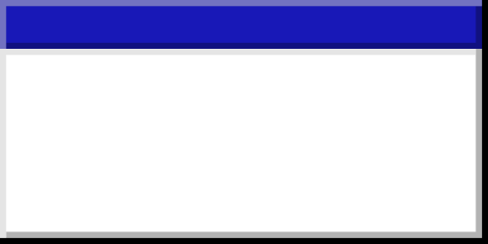

LSTM-BASED DEEPFAKE DETECTION • LSTM-BASED DEEPFAKE DETECTION • LSTM-BASED DEEPFAKE DETECTION• LSTM-BASED DEEPFAKE DETECTION
WHY DEEPFAKE?
Misinformation and Fake News
Character Assassination and Defamation
Political Manipulation
Fraud and Scams
Identity Theft
Revenge Porn and Harassment
Cyberbullying and Social Manipulation
Targeting Businesses and Institutions
Erosion of Trust
LSTM-BASED DEEPFAKE DETECTION • LSTM-BASED DEEPFAKE DETECTION • LSTM-BASED DEEPFAKE DETECTION• LSTM-BASED DEEPFAKE DETECTION

Slide 8
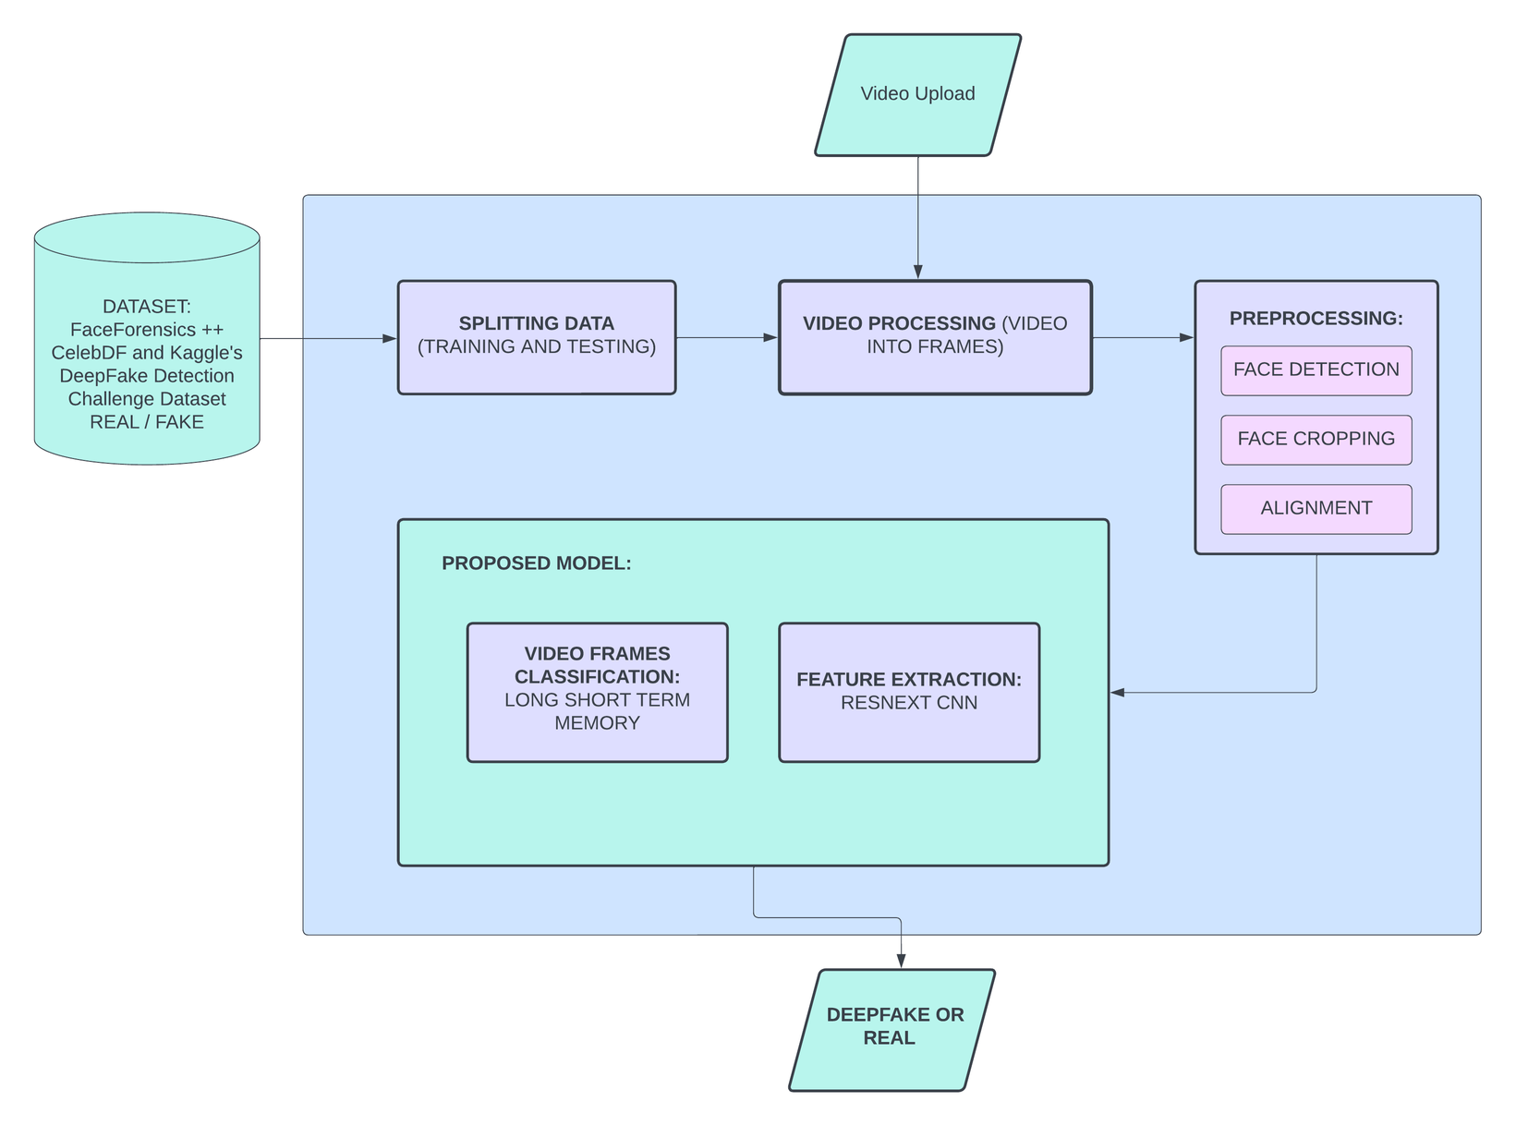

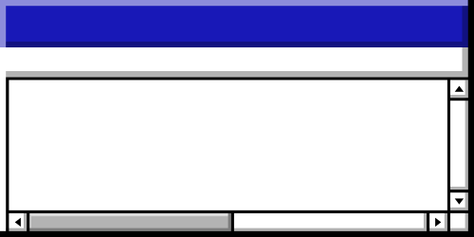
SYSTEM ARCHITECTURE
Back to Agenda Page
METHODOLOGY

Slide 9



LSTM-BASED DEEPFAKE DETECTION • LSTM-BASED DEEPFAKE DETECTION • LSTM-BASED DEEPFAKE DETECTION• LSTM-BASED DEEPFAKE DETECTION
FaceForensic++
Celeb-DF Dataset
DATASETS
Kaggle Deepfake Detection Challenge Dataset

Slide 10
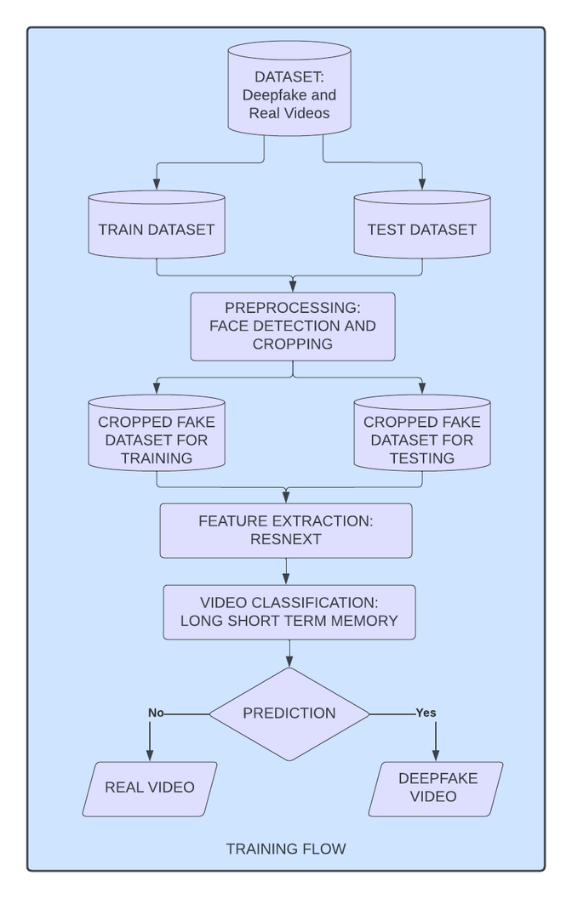
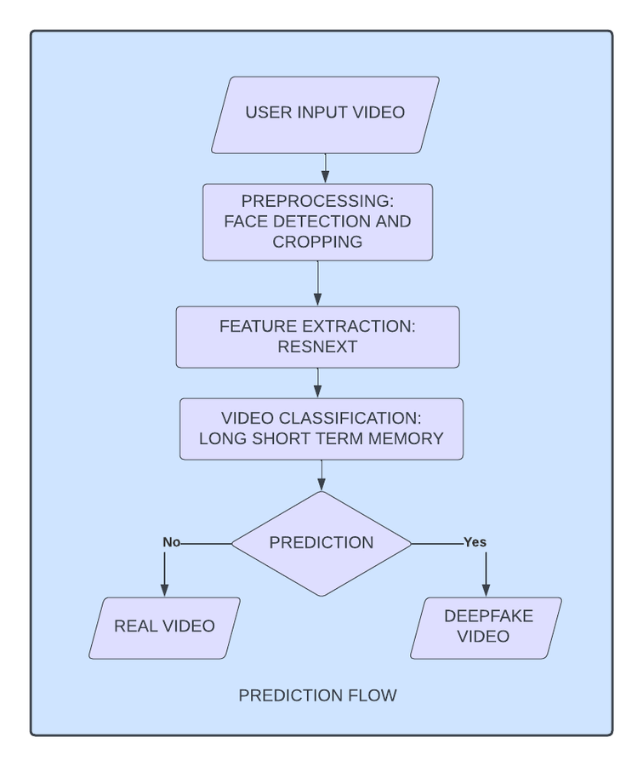
PREDICTION FLOW
TRAINING FLOW
Back to Agenda Page
METHODOLOGY

Slide 11
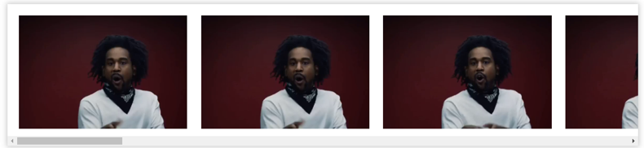
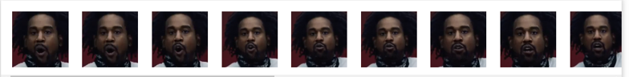


PREPROCESSING:
SPLITTING VIDEO INTO FRAMES
FACE DETECTION
CROPPING FACE
NEW CROPPED VIDEO
Back to Agenda Page

Slide 12
LSTM-BASED DEEPFAKE DETECTION • LSTM-BASED DEEPFAKE DETECTION • LSTM-BASED DEEPFAKE DETECTION• LSTM-BASED DEEPFAKE DETECTION
ResNext CNN for Feature Extraction
MODEL
LSTM as Classifier

Slide 13


ResNext CNN
for Feature Extraction
We use the ResNext CNN classifier to extract features and accurately detect frame-level features. Afterward, we will finetune the network by adding the necessary additional layers and selecting an appropriate learning rate to ensure the gradient descent of the model converges effectively. The 2048- dimensional feature vectors obtained after the last pooling layers will serve as the input to the sequential LSTM.

Slide 14
LSTM as Classifier
For classification, we will use an LSTM-based algorithm. The LSTM will take the sequence of 2048-dimensional feature vectors obtained from the ResNext CNN as input. The LSTM will process the sequence in a sequential manner, considering the temporal dependencies between frames, thus enabling the model to perform temporal analysis of the video. The objective of the classifier is to determine whether the input video sequence is part of a deep fake video or an untampered video.
The LSTM-based classifier will be designed with appropriate layers and dropout regularization to prevent overfitting and improve the model's generalization capabilities.

Slide 15
LSTM-BASED DEEPFAKE DETECTION • LSTM-BASED DEEPFAKE DETECTION • LSTM-BASED DEEPFAKE DETECTION• LSTM-BASED DEEPFAKE DETECTION
We developed web-based deep fake detection using ResNext for feature extraction and Long-Short-Term-Memory (LSTM) for video classification. Users can input a video into the system, and the model will determine whether the video is a deepfake or a genuine video.
We also got high accuracy rate of 91.457% after testing the model.
RESULT

Slide 16
LSTM-BASED DEEPFAKE DETECTION • LSTM-BASED DEEPFAKE DETECTION • LSTM-BASED DEEPFAKE DETECTION• LSTM-BASED DEEPFAKE DETECTION
We developed a web-based deepfake detection system using a neural network-based approach to classify videos as either deep fakes or genuine.
We got high accuracy that shows the effectiveness of our proposed method, which utilizes state-of-the-art deep learning techniques for robust detection. The system's real-time capabilities allow for efficient and reliable deepfake detection, making it a valuable tool in identifying potentially deceptive content.
As with any detection system, continuous improvements and updates are necessary to keep up with evolving deepfake generation techniques.
Conclusion

Slide 17
LSTM-BASED DEEPFAKE DETECTION • LSTM-BASED DEEPFAKE DETECTION • LSTM-BASED DEEPFAKE DETECTION• LSTM-BASED DEEPFAKE DETECTION
Our current method focuses solely on video content for deepfake detection and does not account for audio analysis. As a result, it may not be able to detect audio deep fakes.
Additionally, our deepfake detection model relies on publicly available datasets, including FaceForensics++, CelebDF, and Kaggle's Deep Fake Detection Challenge Dataset.
Despite these limitations, our method demonstrates promising results in accurately identifying deepfake videos based on analyzed features and temporal patterns
Limitation

Slide 18
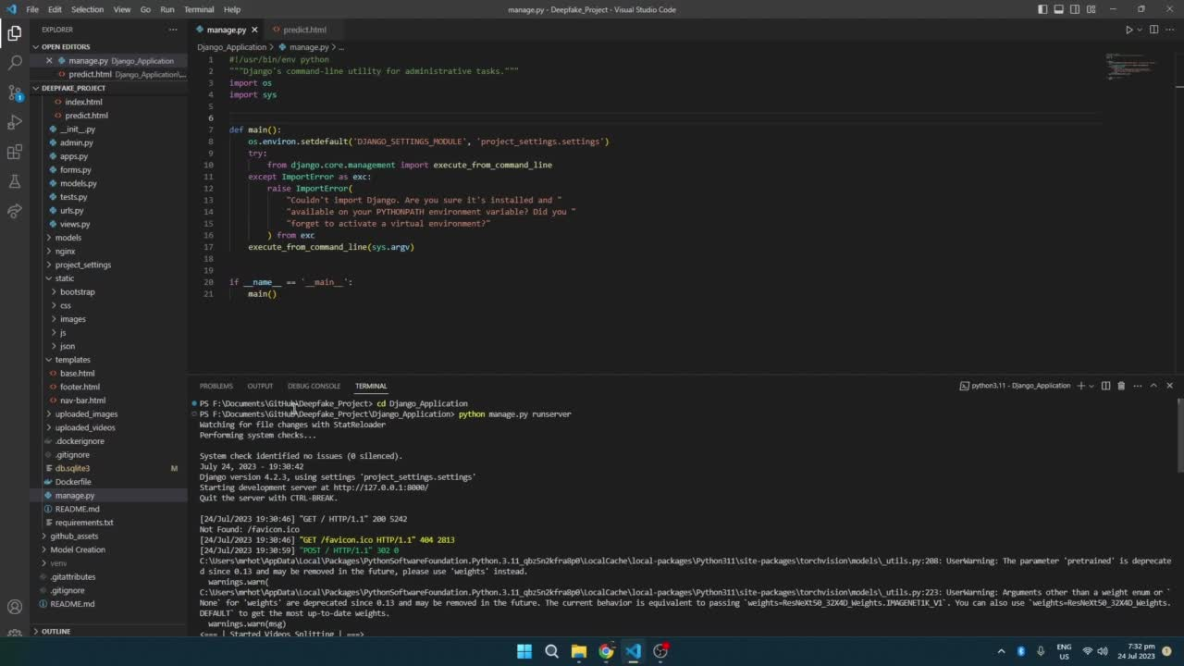
System
Demo
Back to Agenda Page

